Slide 1
DeepFake Video Detection System
R.N.G. Patel Institute of Technology
Team ID :- Team_3561
Team Leader :- Mr. Dhruv Mojila
Team Members:- Mr. Manish Awtani
Miss. Vidhi Patel
Mentor Name:- Mr. Amol Patil

Slide 2


AGENDA
To create a deep fake detection system so that to classify the video as deep fake or real.

Slide 3






PROBLEM STATEMENT
AI-generated fake content, commonly called Deepfakes, have been raising new issues and concerns.

Slide 4
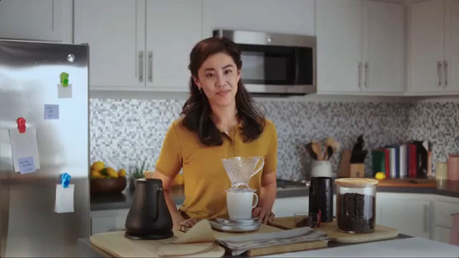
INTRODUCTION
Deep fake is a technique for human image synthesis based on artificial intelligence.
Deep fakes are created by combing and superimposing existing images and videos onto source images or videos using a deep learning technique known as Generative Adversarial Network.

Slide 5
Can you detect the DeepFakes with naked eyes?

Slide 6
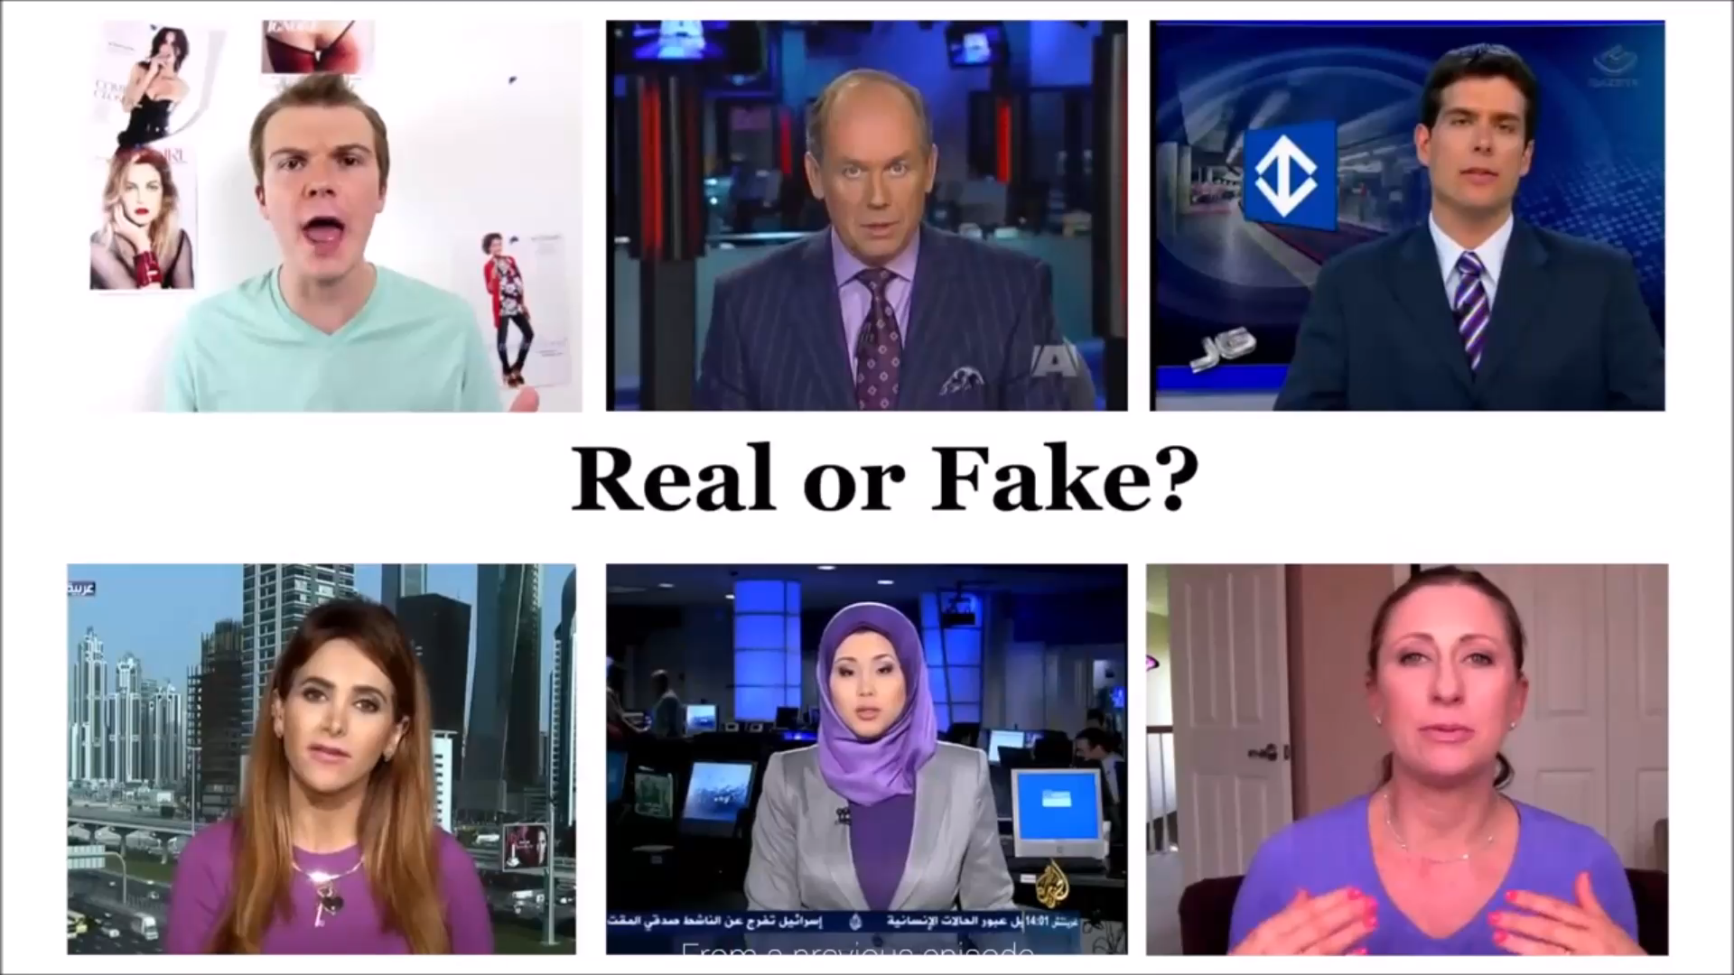

Slide 7
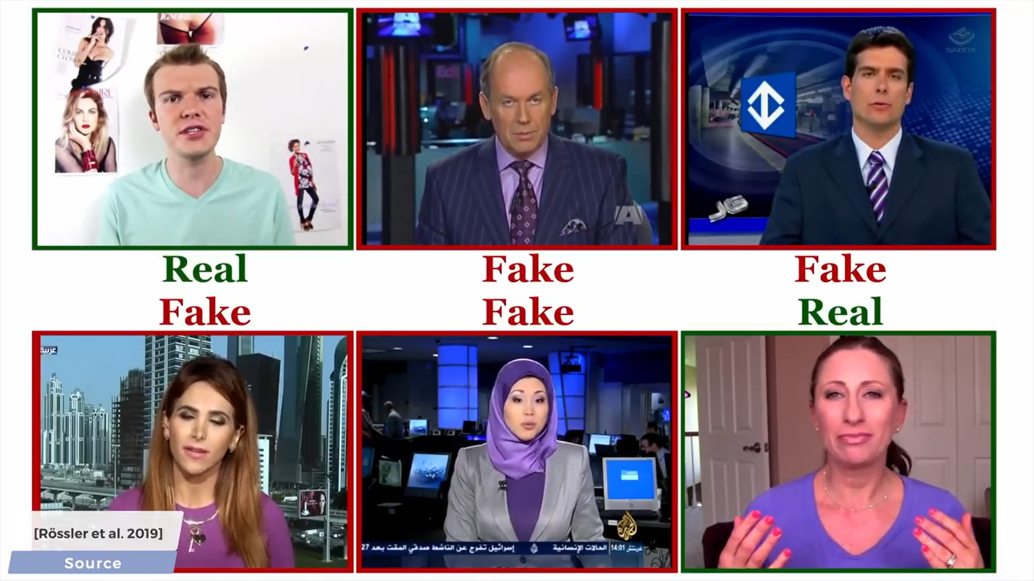

Slide 8
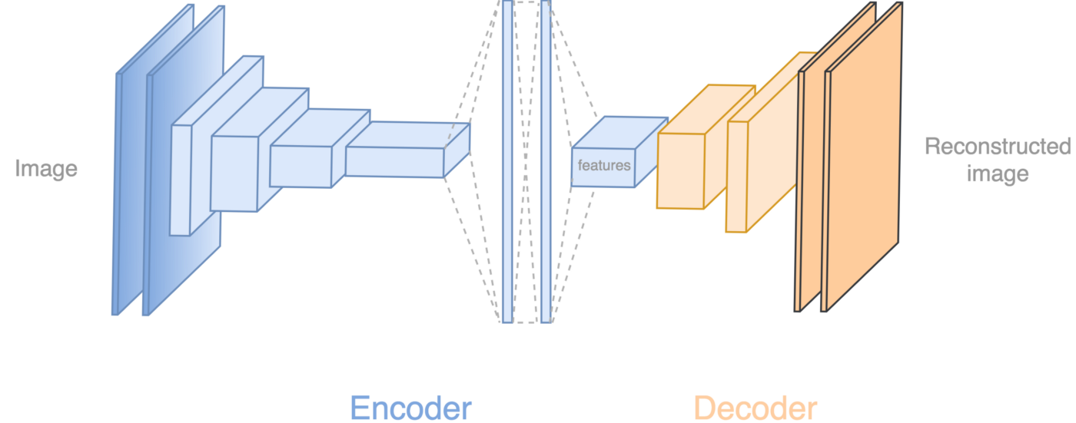
HOW DEEPFAKES ARE CREATED?
Tools for deep fake creation.
Faceswap
Faceit
DeepFaceLab
DeepfakeCapsuleGAN
Large resolution facemasked

Slide 9


TOOLS FOR DEEP FAKE CREATION.

Slide 10
PROJECT OVERVIEW
Free deep learning-based software tools have made it easier to create believable face swaps in films that leave minimal evidence of manipulation, known as "DeepFake" (DF). Manipulations of digital videos have been demonstrated for several decades through the good use of visual effects, current developments in deep learning have resulted in a significant improvement in the realism of fake content as well as the simplicity of its creation. These so-called AI-synthesized media (popularly referred to as DF). Using artificially intelligent technologies to create the DF is a straightforward process. However, detecting these DF is a significant problem because it is difficult to teach the algorithm to detect the DF. Using Convolutional Neural Networks and Recurrent Neural Networks, we have made progress in identifying the DF. At the frame level, the system apply a convolutional Neural network (CNN) to extract features. These characteristics are used to train a recurrent neural network (RNN), which learns to classify whether or not a video has been manipulated and can detect the temporal irregularities between frames generated by DF generation tools. Expected result against a large set of fake videos collected from standard data set.

Slide 11












WHO ARE THE END USERS?
Real world people
Government
Agencies
Police Force

Slide 12
THE WOW FACTOR IN OUR SOLUTION
Spreading of false information and reputational harm have risen alongside with the global rise of deep fakes.
Our model's impressive feature is that it not only recognises deep fakes but also takes n frames, compares their statistical values to one another, and conducts a qualitative analysis of each frame's facial pattern to detect deep fakes.

Slide 13
Dataset used:
FaceForensic++
DeepFake Detection Challenge Dataset
Celeb-Df Dataset

Slide 14
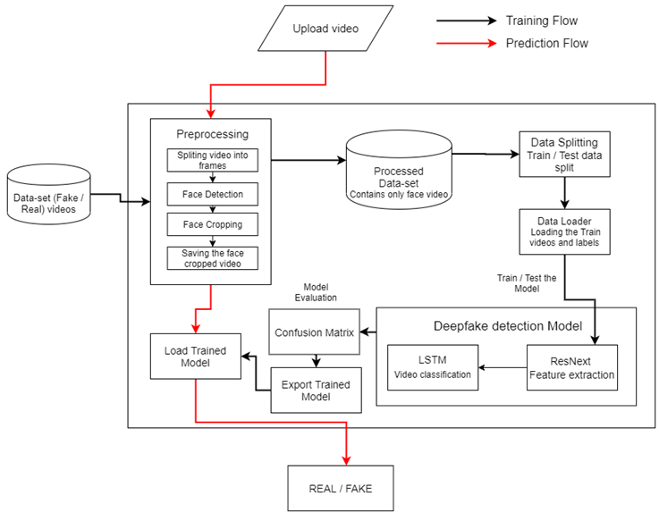
MODELLING

Slide 15










MODELLING
Load trained Model
User Video
4
Real
Prediction
Fake
Preprocessing face detection

Slide 16


Slide 17
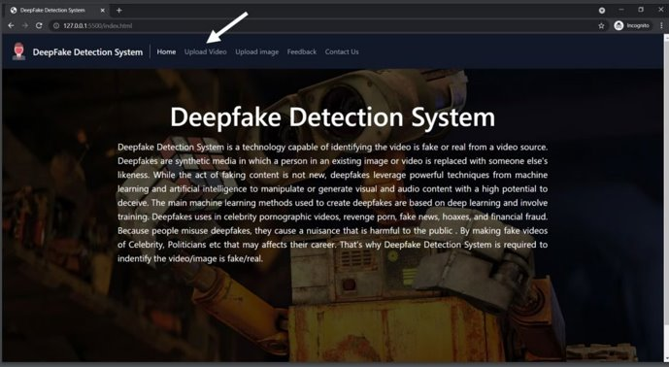
RESULTS - Home Page

Slide 18
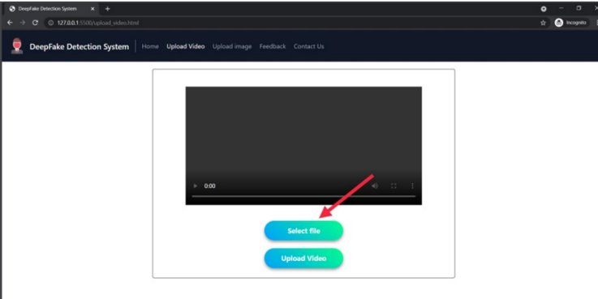
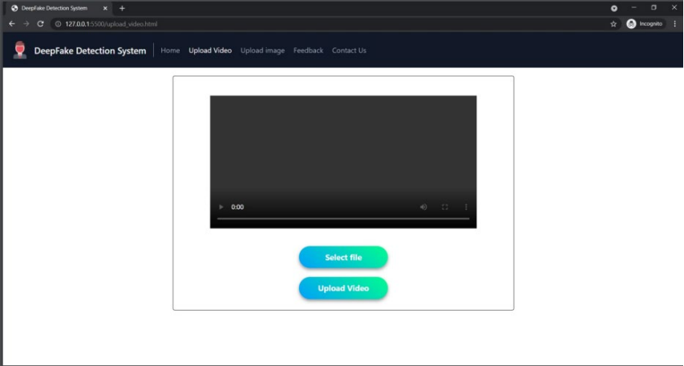
RESULTS - Upload Video Page

Slide 19
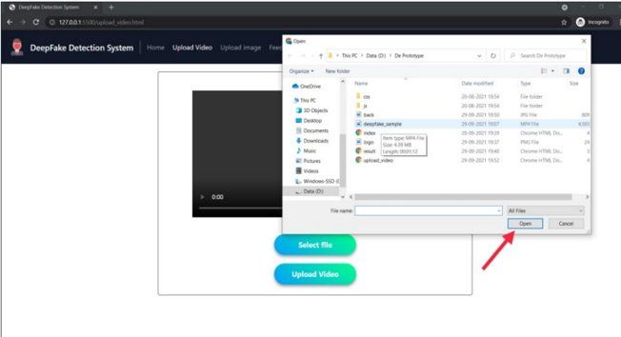
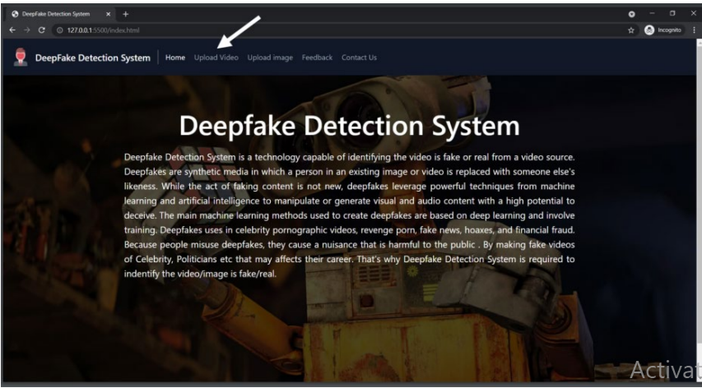
Uploading Video

Slide 20
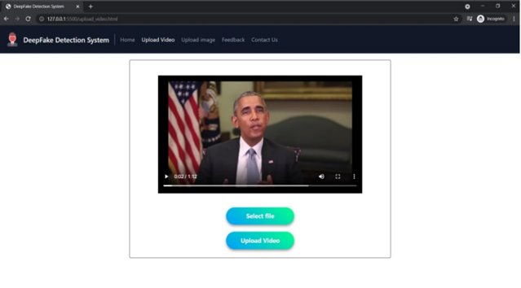
Video Selected

Slide 21
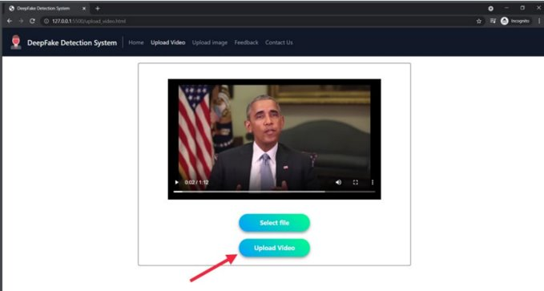

Click on Upload Video

Slide 22

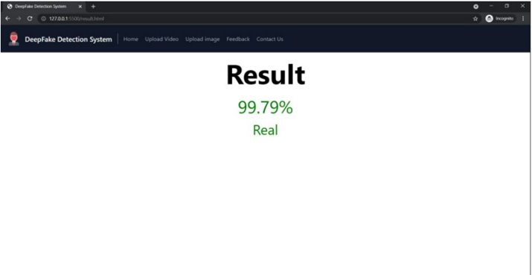
RESULTS – Evaluation Page For Real Video

Slide 23
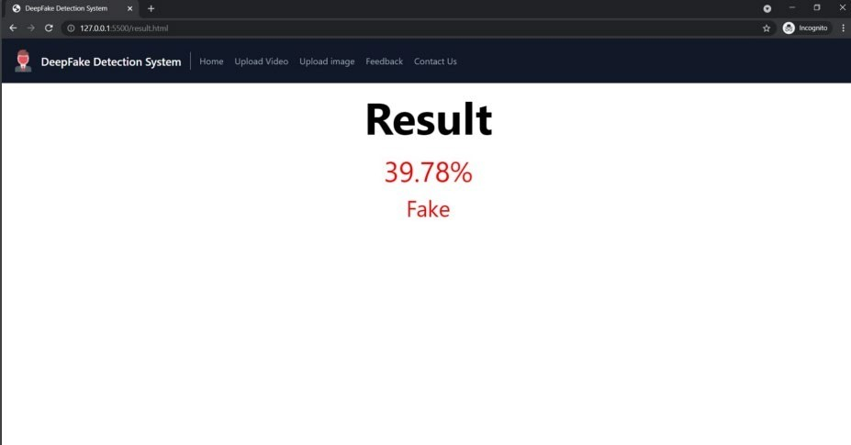
RESULTS – Evaluation Page For Fake Video

Slide 24
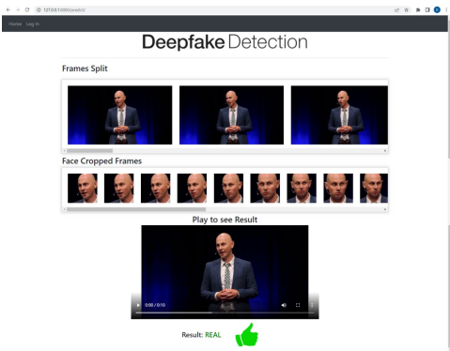
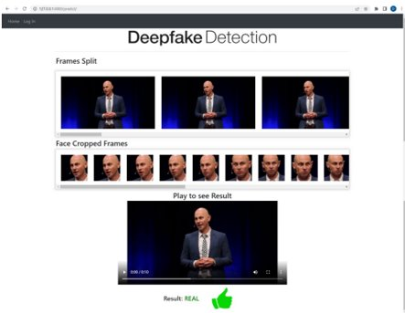
RESULTS – Split Screen

Slide 25
Live Demo

Slide 26


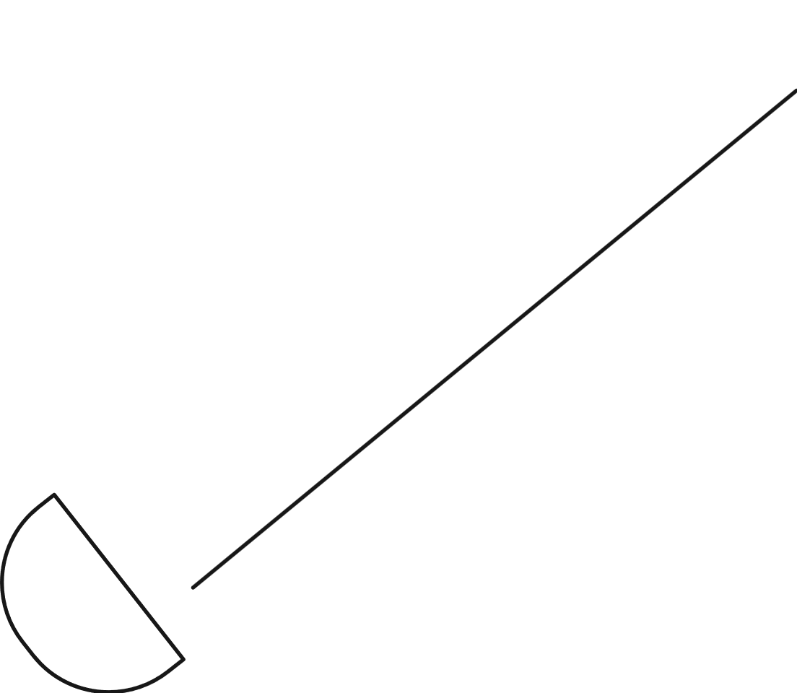
CONCLUSION
We presented a neural network-based approach to classify the video as deep fake or real, along with the confidence of proposed model.
The proposed method is inspired by the way the deep fakes are created by the GANs with the help of Auto encoders.
Our method does the frame level detection using ResNext CNN and video classification using RNN along with LSTM. The proposed method is capable of detecting the video as a deep fake or real based on the listed parameters.
We believe that, it will provide a very high accuracy on real time data.

Slide 27



MEET OUR TEAM
Manish Awtani
Vidhi Patel
Dhruv Mojila

Slide 28


